Slide 1


Project “Escape Room”
Software Design Patterns
By Gursheen, Mihir, Apoorva, Harshil

Slide 2

About The Game
Welcome to the Escape Room! This is a challenging and immersive game where you will need to use your problem-solving skills, and creativity to escape from a series of rooms.
To start, you will select a theme for your game. Each theme has its own unique set of rooms and challenges. Once you have selected a theme, you will be transported into a room that is themed accordingly.
The goal of the game is to escape from the room within a time limit. To do this, you will need to find clues and solve puzzles.
There are three rooms in total. Each room is more challenging than the last. If you are able to escape from all three rooms within the time limit, you will win the game!

Slide 3
Start
Creates
User Profile
Clone
User
Initiated with EntryState
GameClass, created using Facade
Selects
Theme
Room
Subscribe
Puzzle
Using Builder pattern and singleton factory,
bridge pattern to separate implementation and abstraction, changes the state of user as user moves through rooms
Timer(Observer)
Built using Template Pattern and holds list of rooms using object composition
Get hint using command pattern where the receiver adapted to a new API also consists of a decorator option for timed puzzles
Built using Strategy pattern for different kind of puzzles
Hint

Slide 4
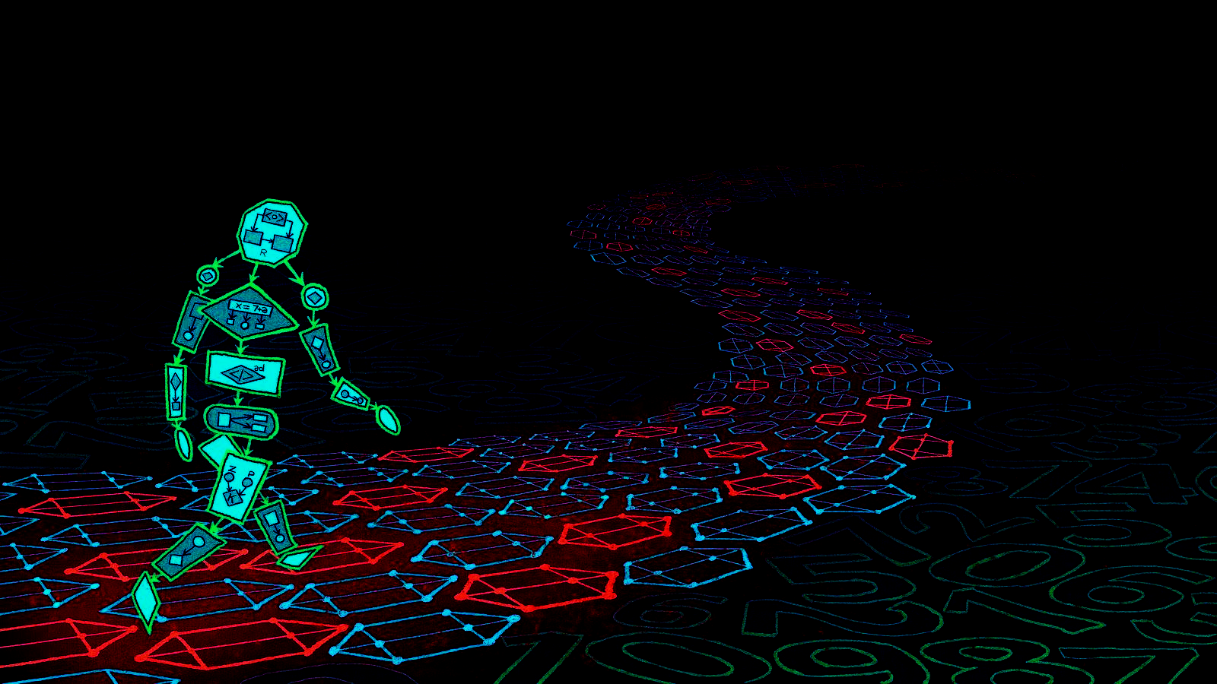
Thank You!
Any Questions?

